Slide 1
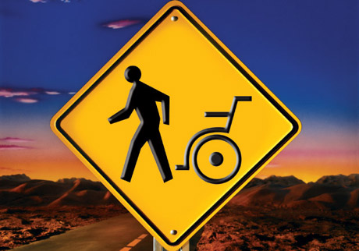
THE SEASON OF MIRACLES

Slide 2
THE SEASON OF MIRACLES
Isa 8:18 Behold, I and the children whom the LORD hath given me are for signs and for wonders in Israel from the LORD of hosts, which dwelleth in mount Zion.

Slide 3
THE SEASON OF MIRACLES
Supernatural: of, relating to, or being above or beyond what is natural; unexplainable by natural law or phenomena; abnormal.

Slide 4
THE SEASON OF MIRACLES
WHAT IS A MIRACLE?
Miracle: in the Hebrew is “mowpheth” meaning wonder, sign.
Miracle: wonder (as a special display of God's power) sign, token (of future event)

Slide 5
THE SEASON OF MIRACLES
Dan 11:32 And such as do wickedly against the covenant shall he corrupt by flatteries: but the people that do know their God shall be strong, and do exploits.

Slide 6
THE SEASON OF MIRACLES
WHAT DO YOU EXPECT?
Col 3:1 If ye then be risen with Christ, seek those things which are above, where Christ sitteth on the right hand of God. Col 3:2 Set your affection on things above, not on things on the earth. Col 3:3 For ye are dead, and your life is hid with Christ in God.

Slide 7
THE SEASON OF MIRACLES
Affection: to be of the same mind i.e. agreed together, cherish the same views, be harmonious
to direct one's mind to a thing, to seek, to strive for
to seek one's interest or advantage
to be of one's party, side with him (in public affairs)

Slide 8
THE SEASON OF MIRACLES
2Kings 4:1-7
Mark 5:25-34
John 6:5-12
Acts 3: 1-9

