Slide 1
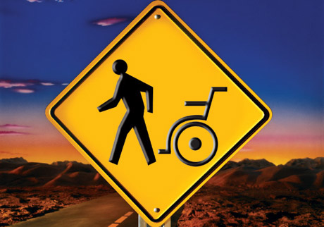
THE SEASON OF MIRACLES

Slide 2
THE SEASON OF MIRACLES
Isa 8:18 Behold, I and the children whom the LORD hath given me are for signs and for wonders in Israel from the LORD of hosts, which dwelleth in mount Zion.

Slide 3
THE SEASON OF MIRACLES
Supernatural: of, relating to, or being above or beyond what is natural; unexplainable by natural law or phenomena; abnormal.

Slide 4
THE SEASON OF MIRACLES
WHAT IS A MIRACLE?
Miracle: in the Hebrew is “mowpheth” meaning wonder, sign.
Miracle: wonder (as a special display of God's power) sign, token (of future event)

Slide 5
THE SEASON OF MIRACLES
“Facing the Giants”
Num 13:2 Send thou men, that they may search the land of Canaan, which I give unto the children of Israel: of every tribe of their fathers shall ye send a man, every one a ruler among them.

Slide 6
THE SEASON OF MIRACLES
Num 13:32 And they brought up an evil report of the land which they had searched unto the children of Israel, saying, The land, through which we have gone to search it, is a land that eateth up the inhabitants thereof; and all the people that we saw in it are men of a great stature.

Slide 7
THE SEASON OF MIRACLES
Process: a systematic series of actions directed to some end: a continuous action, operation, or series of changes taking place in a definite manner:

Slide 8
THE SEASON OF MIRACLES
Process is always required it’s just NOT always the SAME
Judges 16:20 And she said, The Philistines be upon thee, Samson. And he awoke out of his sleep, and said, I will go out as at other times before, and shake myself. And he wist not that the LORD was departed from him.

Slide 9
THE SEASON OF MIRACLES
Jhn 5:6 When Jesus saw him lie, and knew that he had been now a long time in that case, he saith unto him, Wilt thou be made whole?
Jhn 5:7 The impotent man answered him, Sir, I have no man, when the water is troubled, to put me into the pool: but while I am coming, another steppeth down before me.

Slide 10
THE SEASON OF MIRACLES
In order to release the “God Potential” in you. God will bring you into a place where the Supernatural is no longer an option but a REQUIREMENT!
The Supernatural takes you PASS the IMPOSSIBLE, through the UNBELIVABLE, into the RIDICULES!

Slide 11
THE SEASON OF MIRACLES
Potential: possible, as opposed to actual:
Capacity: the ability to receive or contain: power of receiving impressions, knowledge, etc.; mental ability. position; function; role:
Capability: a skill, an ability, or knowledge that makes a person able to do a particular job

Slide 12
THE SEASON OF MIRACLES
Consider the Text……
1John 4:3-4
1John 3:2
Gen. 1:2
Gen. 2:7
1Tim 4:12-16
Eph. 3:20

Slide 13
THE SEASON OF MIRACLES
Faith Under Pressure Produces the Supernatural
James 2-4(MSG) Consider it a sheer gift, friends, when tests and challenges come at you from all sides. You know that under pressure, your faith-life is forced into the open and shows its true colors. So don’t try to get out of anything prematurely. Let it do its work so you become mature and well-developed, not deficient in any way.

