Slide 1


Slide 2
KINGDOM MAN
Mat 12:29 Or else how can one enter into a strong man's house, and spoil his goods, except he first bind the strong man? and then he will spoil his house.

Slide 3
KINGDOM MAN
God never said a godly life would be easy; He just said it would be worth it.

Slide 4
KINGDOM MAN
DISTRACTION: dis·trac·tion
something that makes it difficult to think or pay attention
: something that amuses or entertains you so that you do not think about problems, work, etc.
: a state in which you are very annoyed or upset

Slide 5
KINGDOM MAN
Pro 23:6 Do not eat the bread of a miser, Nor desire his delicacies;
Pro 23:7 For as he thinks in his heart, so is he. "Eat and drink!" he says to you, But his heart is not with you.

Slide 6
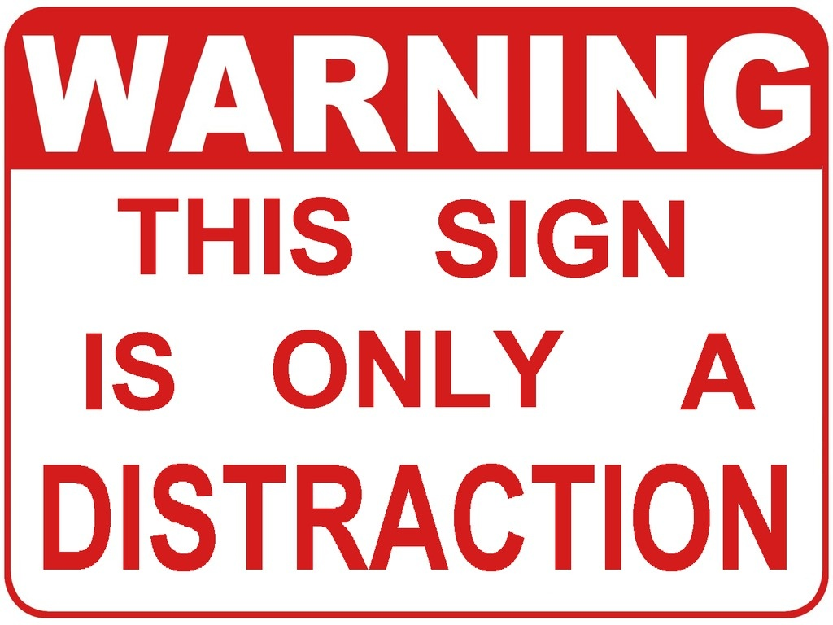

Slide 7
KINGDOM MAN
King David’s
5 Steps to a downfall
Wrong Place, Wrong Time
Stop Looking…Stop Lying
That’s NOT yours
Fig leaves AGAIN!
Blood on your Hands

Slide 8
KINGDOM MAN
Wrong place, Wrong Time
It is said that right after great successes comes the greatest risk for a great fall
In 1 Samuel 11:1 we see that it was “In the spring of the year, the time when kings go out to battle” that David was still in the palace.

Slide 9
KINGDOM MAN
Stop Looking…Stop Lying
“It happened, late one afternoon, when David arose from his couch and was walking on the roof of the king’s house, that he saw from the roof a woman bathing; and the woman was very beautiful” (1 Sam 11:2).
Matt. 6:22-23, Job 31:1, Prov. 6:27

Slide 10
KINGDOM MAN
That’s NOT yours
1 Samuel 11:3 “David sent and inquired about the woman. And one said, “Is not this Bathsheba, the daughter of Eliam, the wife of Uriah the Hittite?”
Exd. 20:17, Gen. 39:9

Slide 11
KINGDOM MAN
Fig Leaves…Again
2Sa 11:9 But Uriah slept at the door of the king's house with all the servants of his lord, and went not down to his house.
Gen 3:7, 1John 1:9

Slide 12
KINGDOM MAN
Blood on your Hands
2Sa 11:15 In the letter he wrote, "Set Uriah in the forefront of the hardest fighting, and then draw back from him, that he may be struck down, and die.“
2Sam 12:10, Eph 6:4

Slide 13
KINGDOM MAN
PMS
POWER
SEX
MONEY

Slide 14
KINGDOM MAN
DON’T LET YOUR POWER ABUSE YOU
YOUR MONEY USE YOU
&
YOUR SEX LIFE RULE YOU

