Slide 1
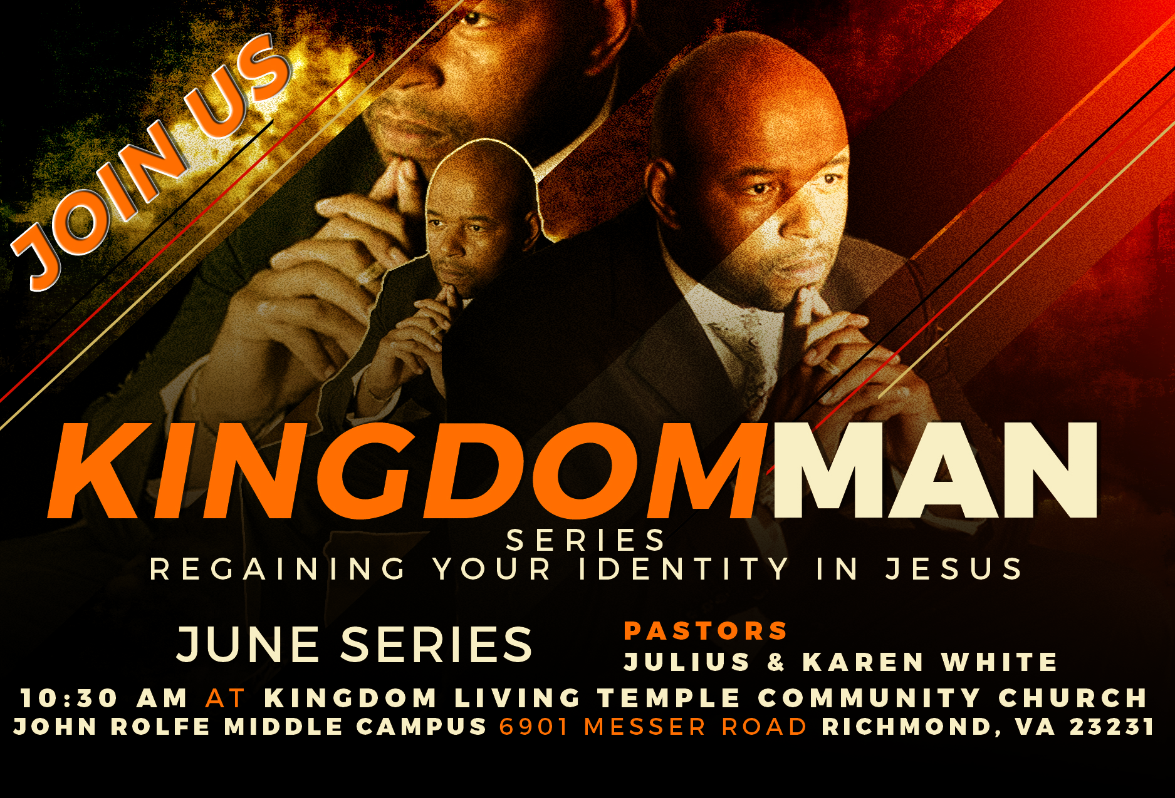

Slide 2
KINGDOM MAN
Job 2:3 And the Lord said to Satan, "Have you considered my servant Job, that there is none like him on the earth, a blameless and upright man, who fears God and turns away from evil? He still holds fast his integrity, although you incited me against him to destroy him without reason." 4Then Satan answered the Lord and said, "Skin for skin! All that a man has he will give for his life

Slide 3
KINGDOM MAN
5But stretch out your hand and touch his bone and his flesh, and he will curse you to your face." 6And the Lord said to Satan, "Behold, he is in your hand; only spare his life." 7So Satan went out from the presence of the Lord and struck Job with loathsome sores from the sole of his foot to the crown of his head. 8And he took a piece of broken pottery with which to scrape himself while he sat in the ashes.

Slide 4
KINGDOM MAN
9Then his wife said to him, "Do you still hold fast your integrity? Curse God and die." 10But he said to her, "You speak as one of the foolish women would speak. Shall we receive good from God, and shall we not receive evil?" In all this Job did not sin with his lips.
(ESV)

Slide 5
KINGDOM MAN
Character: the way someone thinks, feels, and behaves : someone's personality, one of the attributes or features that make up and distinguish an individual
Integrity: an unimpaired condition, soundness, wholeness 2) firm adherence to a code of moral values, i.e., incorruptible, honor, 3) the quality or state of being complete or undivided, i.e., completeness.

Slide 6
KINGDOM MAN
God is integrity. He does not merely act with integrity; integrity is his character.
1Pe 1:15 But as he which hath called you is holy, so be ye holy in all manner of conversation; 1Pe 1:16 Because it is written, Be ye holy; for I am holy.

Slide 7
KINGDOM MAN
Jer 29:11 For I know the plans I have for you, declares the LORD, plans for welfare [fn] and not for evil, to give you a future and a hope. Jer 29:12 Then you will call upon me and come and pray to me, and I will hear you. Jer 29:13 You will seek me and find me, when you seek me with all your heart.

Slide 8
KINGDOM MAN
DISTRACTION: dis·trac·tion
something that makes it difficult to think or pay attention
: something that amuses or entertains you so that you do not think about problems, work, etc.
: a state in which you are very annoyed or upset

Slide 9
KINGDOM MAN
Image is what people think we are, Integrity is what we really are.
(1Sam.16:7)

Slide 10
KINGDOM MAN
The Impact of Integrity
Integrity builds trust.
Integrity has high influence value.
Integrity sets high standards
Integrity requires living it, before leading it.

Slide 11
KINGDOM MAN
Integrity builds trust
Psalm 26:1-3 Of David. Vindicate me, O Lord, for I have walked in my integrity, and I have trusted in the Lord without wavering. Prove me, O Lord, and try me; test my heart and my mind. For your steadfast love is before my eyes, and I walk in your faithfulness.
(EVS)

Slide 12
KINGDOM MAN
Integrity has high influence value
People’s minds are change through observation not argument.
1Cor 11:1 1Be imitators of me, as I am of Christ.

Slide 13
KINGDOM MAN
Integrity sets High standards
Luke 16:10 “One who is faithful in a very little is also faithful in much, and one who is dishonest in a very little is also dishonest in much.
Matt 25:23 His master said to him, ‘Well done, good and faithful servant. You have been faithful over a little; I will set you over much.

Slide 14
KINGDOM MAN
Integrity requires living it, before leading it.
Potential must become Production
Mat 7:20 Wherefore by their fruits ye shall know them.

Slide 15
KINGDOM MAN
Job 42:10 And the LORD turned the captivity of Job, when he prayed for his friends: also the LORD gave Job twice as much as he had before.

